Slide 1

Bank Marketing Campaign- Term Deposits
By - Natani Drati
Akshita Khandelwal
Souritya Saha

Slide 2
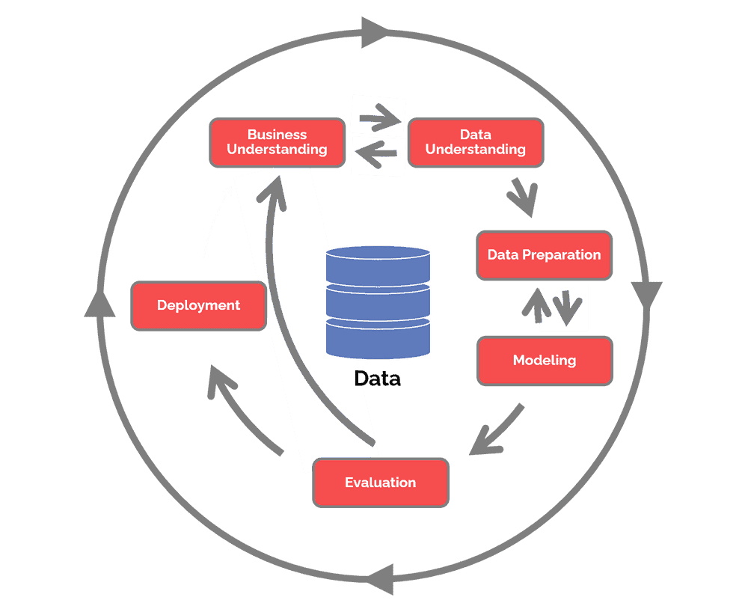
ABSTRACT
The impact of marketing initiatives on the public have decreased over time as their number has grown exponentially.
Marketing managers now spend in targeted campaigns with limited selection of resources due to economic constraints and competitiveness
This study outlines a DM project based on the CRISP-DM (Cross Industry Standard Process for Data Mining ).
The business goal is to find a model that can explain success of a contact, i.e., if the client subscribes the deposit.

Slide 3

INTRODUCTION
This project is related to the direct marketing campaigns of a Portuguese banking institution.
This dataset is about the direct phone call marketing campaigns, by a Portuguese banking institution from May 2008 to November 2010.
It is publicly available in the UCI Machine Learning Website, which can be retrieved from https://archive.ics.uci.edu/ml/datasets/bank+marketing
The entire marketing campaigns were based on reaching clients via phone call.
The classification goal is to predict if the client will subscribe(yes/no) to a term deposit(variable y).

Slide 4

INTRODUCTION
Doing so will increase the productivity and consequently increase the business revenue of the banking institution by acquiring more potential clients.
We hope to develop the best model that predicts whether or not a client will subscribe via the marketing campaign efforts of the Portuguese banking institution using the data we have.

Slide 5
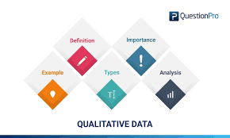
Data Description
Data Source: UCI data mining Archive
Link: https://archive.ics.uci.edu/ml/datasets/bank+marketing
No of records in the dataset: 41,188
No of attributes: 20
Target Variable: ‘y’, Data type: Categorical, range of values: binary ‘yes’ or ‘no’

Slide 6
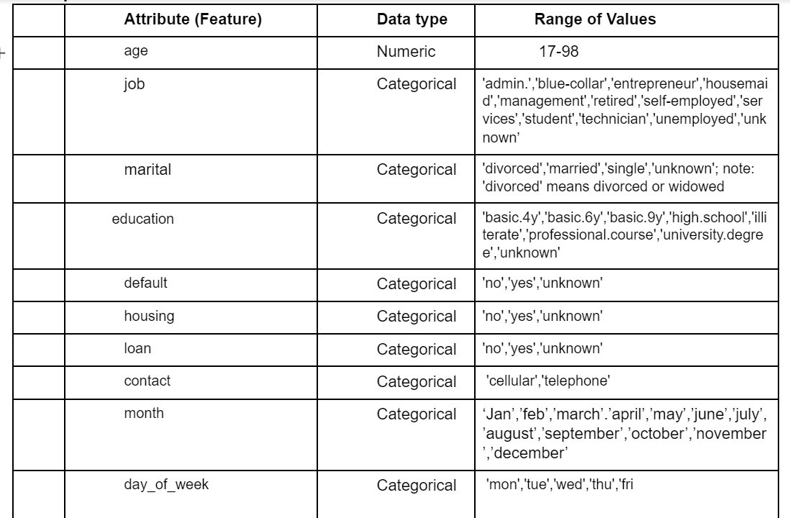
Data Description - Attribute Features
Attributes

Slide 7
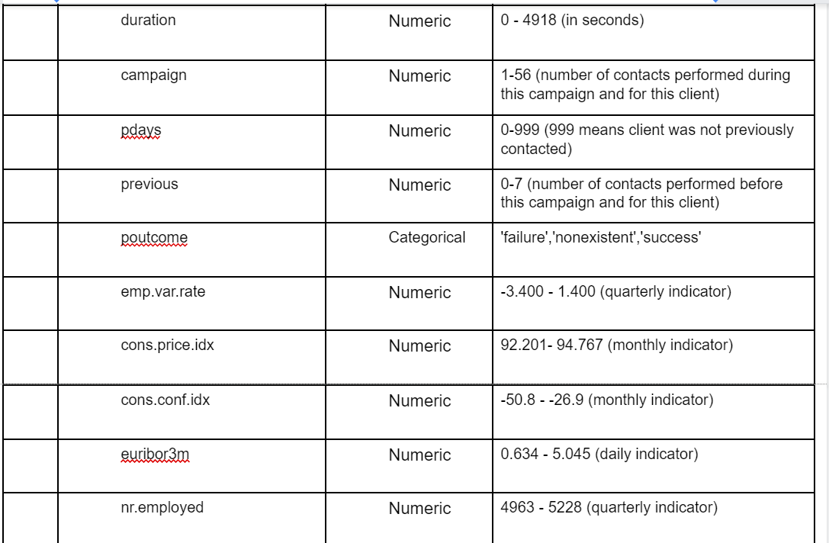
Data Description - Attribute Features
Attributes

Slide 8
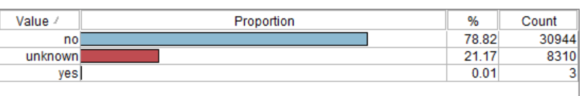
Data processing/Cleaning
Removing Outliers: Campaign, Previous
Kept Outliers in Age - Natural variations
Generated supernode with removed outliers
Removed features(No Role):
Month
Day of the week
Removing Target Leaking variable: Duration
Removing records from dataset with ‘unknown’ values:
The following features have “unknown” values, these instances will be removed as imputing these values would not be beneficial to our models.
Job ⦾Default
Marital ⦾Housing - exception (used “unknown” in Default as its own predictor due to the proportion below)
Education ⦾Loan

Slide 9

Feature engineering
Pdays(amount of days passed from last contact from previous model
Values of 999/1-10
Problem:
Models read feature as continuous
After python algorithm:
New values
Binary Categorical
‘No’: client was not previously contacted
‘Yes’: Client was previously contacted

Slide 10
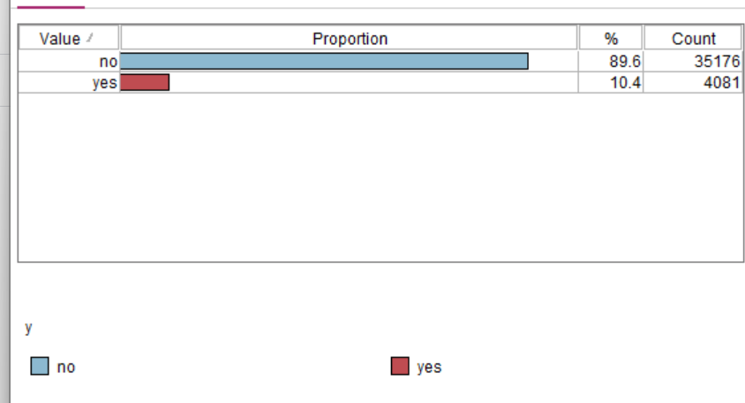
Imbalanced Data
Intrinsic vs extrinsic
Imbalance is intrinsic due to dataset nature
Minority vs majority class
Leads to a un-predictive model
Solutions
Undersampling
Oversampling
Cost sensitive algorithm

Slide 11

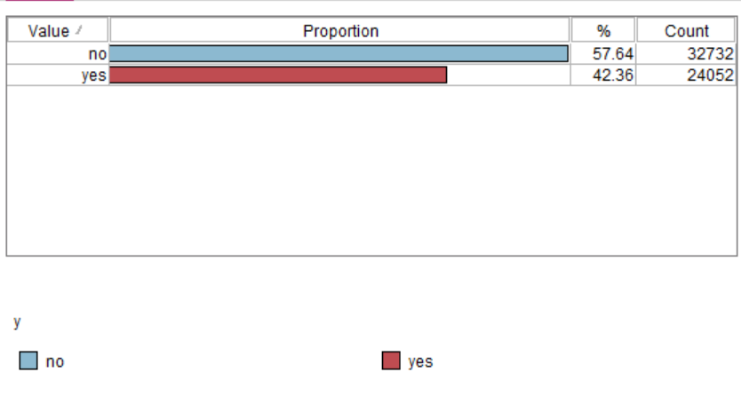
Solving imbalanced Data
Undersampling would delete a lot of significant information due to the large imbalance
Our solution:
SMOTE(Synthetic minority oversampling technique)
Oversamples
KNN
The figure to the right is the distribution of our dataset
after using SMOTE

Slide 12
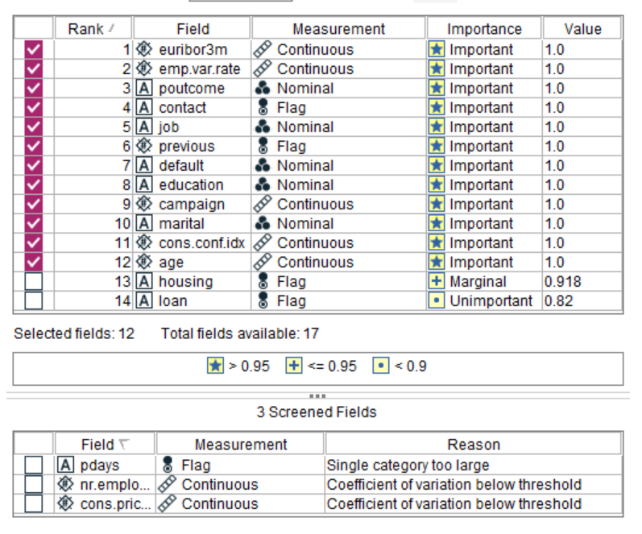
Feature Selection
By valuing the importance of our features
At 0.95
The following 5 unselected features were
removed
Housing
Loan
Pdays
Nr.meployed
Cons.price.index
Not all models performed better with feature selection
but the majority did. (The best model accuracies were reported)

Slide 13

Built Models
Ann
Ability to learn
Logistic Regression
implementation, interpretation,efficient
C5.0 Decision trees
Large multidimensional data
CART Decision trees
Random Forests
Provides a higher level of accuracy/ensemble technique
KNN
Intuitive memory based approach
Ensemble

Slide 14
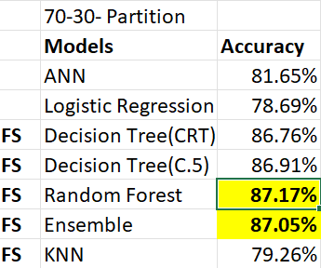
Results and Discussions
This section describes the result generated from data mining.
Overall, there were seven model applied and executed. After comparing the models we can see that the two models with best performance are Random Forest and Ensembles with highest F measure.

Slide 15
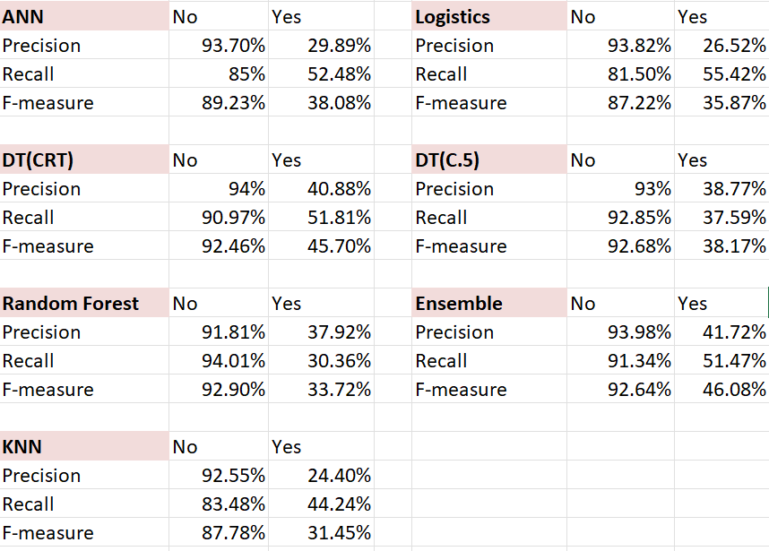
Results
Random Forest F measure performance shows that model has best accuracy with high recall value in terms of our No class. In terms of our Yes class, the Ensemble and the Decision trees performed the best. Yet, the Yes class measures are still very poor overall.
F-measure/Recall/Precision
It’s Important to note that although these measures are performing well for the original majority class (NO),
These measures for the minority class(YES), did not have the same performance and in fact performed poorly.
This poor performance is likely due to the imbalanced dataset regardless of our efforts to balance the dataset by oversampling

Slide 16
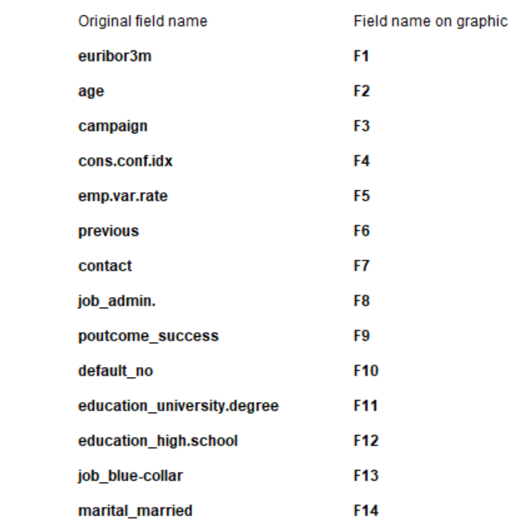
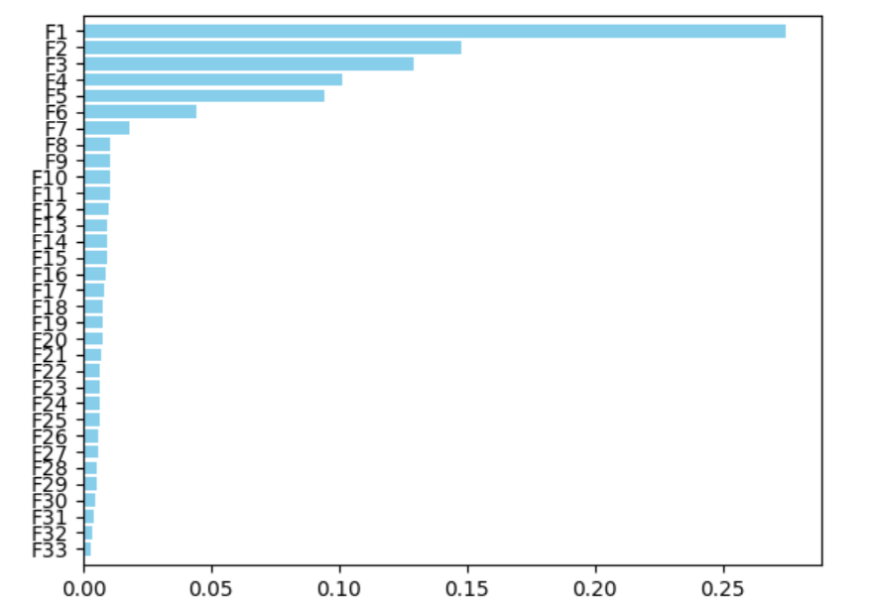
Predictor Importance
Some the top features in our Random Forest Model

Slide 17
Conclusion
The random forest classifier is known to perform well on large datasets due to its ability to grow several unpruned trees and aggregate their predictions by selecting a subset of features to determine the split point.
It was discovered that the use of the ensemble methods is an effective way to improve the performance of the classifiers.
From the balanced dataset, the decision tree algorithm was found to have better performance than logistic regression.
In this research work, the resampling method was used in dealing with the problem of imbalanced data, and machine learning algorithms were deployed to find out the main factor that influences customers decision to subscribe to a term deposit in the bank was euribor 3 month rate.
The top 3 key features or attributes that helped in the prediction of the class variable were:1. Euribor3m 2. Age 3. campaign
We learned banks can recognize market conditions(the interest rate at which a selection of European banks lend one another funds denominated in euros) which are favourable to increase client subscription for the fixed term products they are offering.

Slide 18
Managerial Conclusion
The purpose of this model was to correctly identify clients who would subscribe to a banking term deposit
Our models performed well at identifying which clients wouldn’t subscribe but failed to identify which clients would subscribe to a banking term deposit
Despite our efforts to increase accuracy, and oversample using SMOTE, the minority class Recall,Precision, and F measure were not up to the standard that we would have liked to use in implementation
For that reason, we recommend that we don’t use these models
To improve our models to represent the minority class, we recommend undersampling or applying weights to the classes using a cost-sensitive algorithm to balance the data

Slide 19
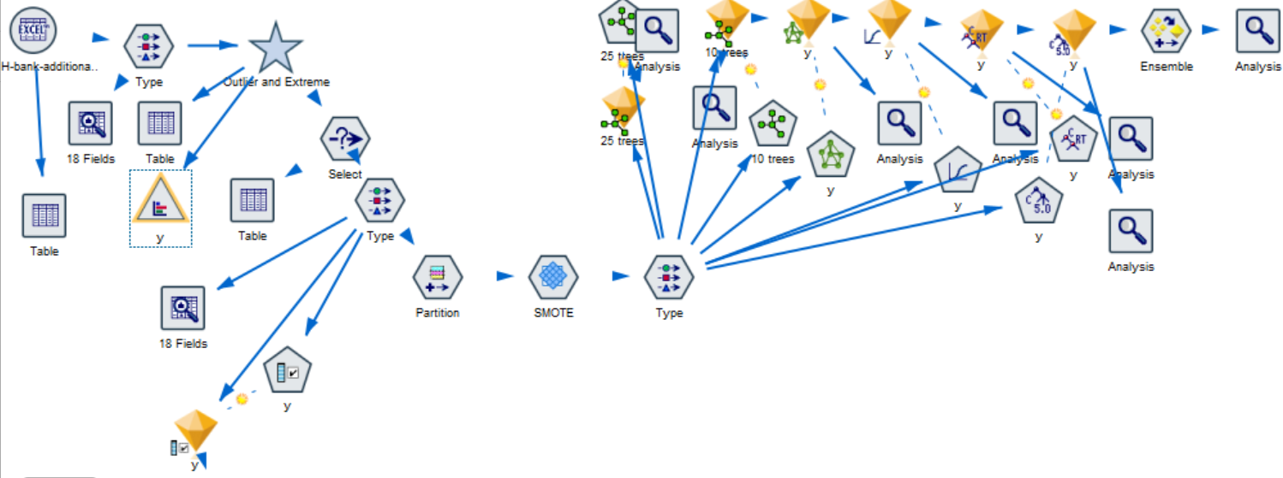
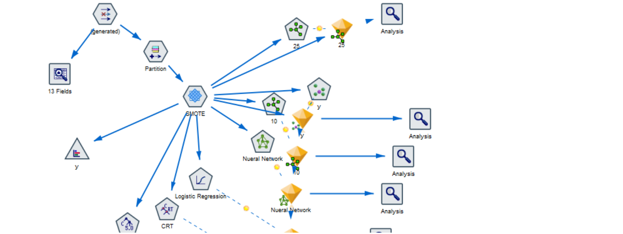

Model stream

